Slide 1
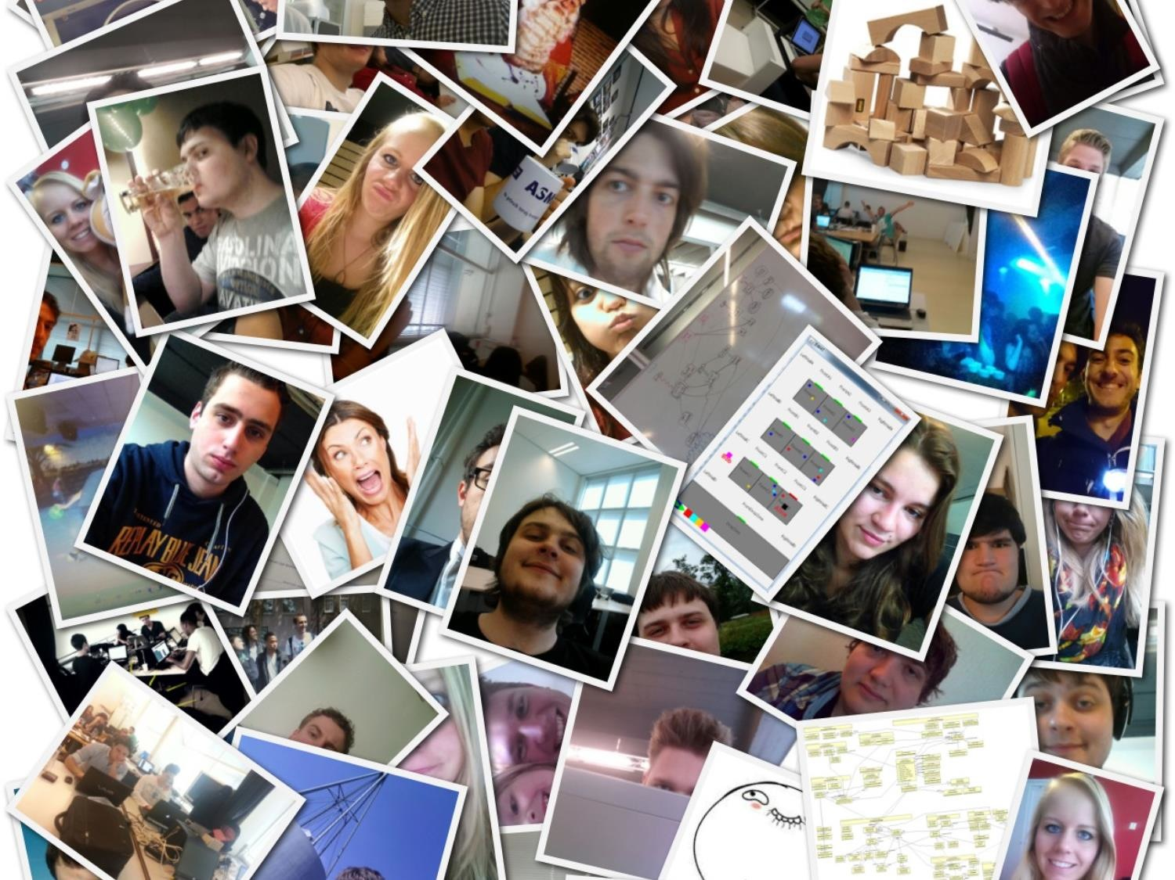
A Search and Rescue Mission
Context Project 2014
Notes:
Tell about 19 students 1 group, working with team is awesome

Slide 2
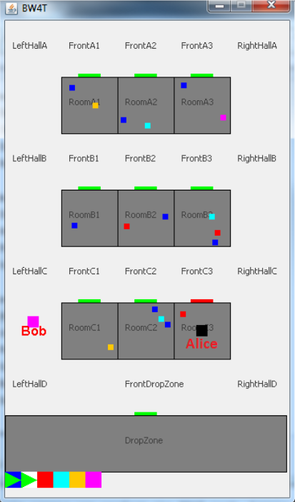
BW4T
Blocks World For Teams
Agent-environment interface used for:
research
in search & rescue field
education
first year computer science course

Slide 3
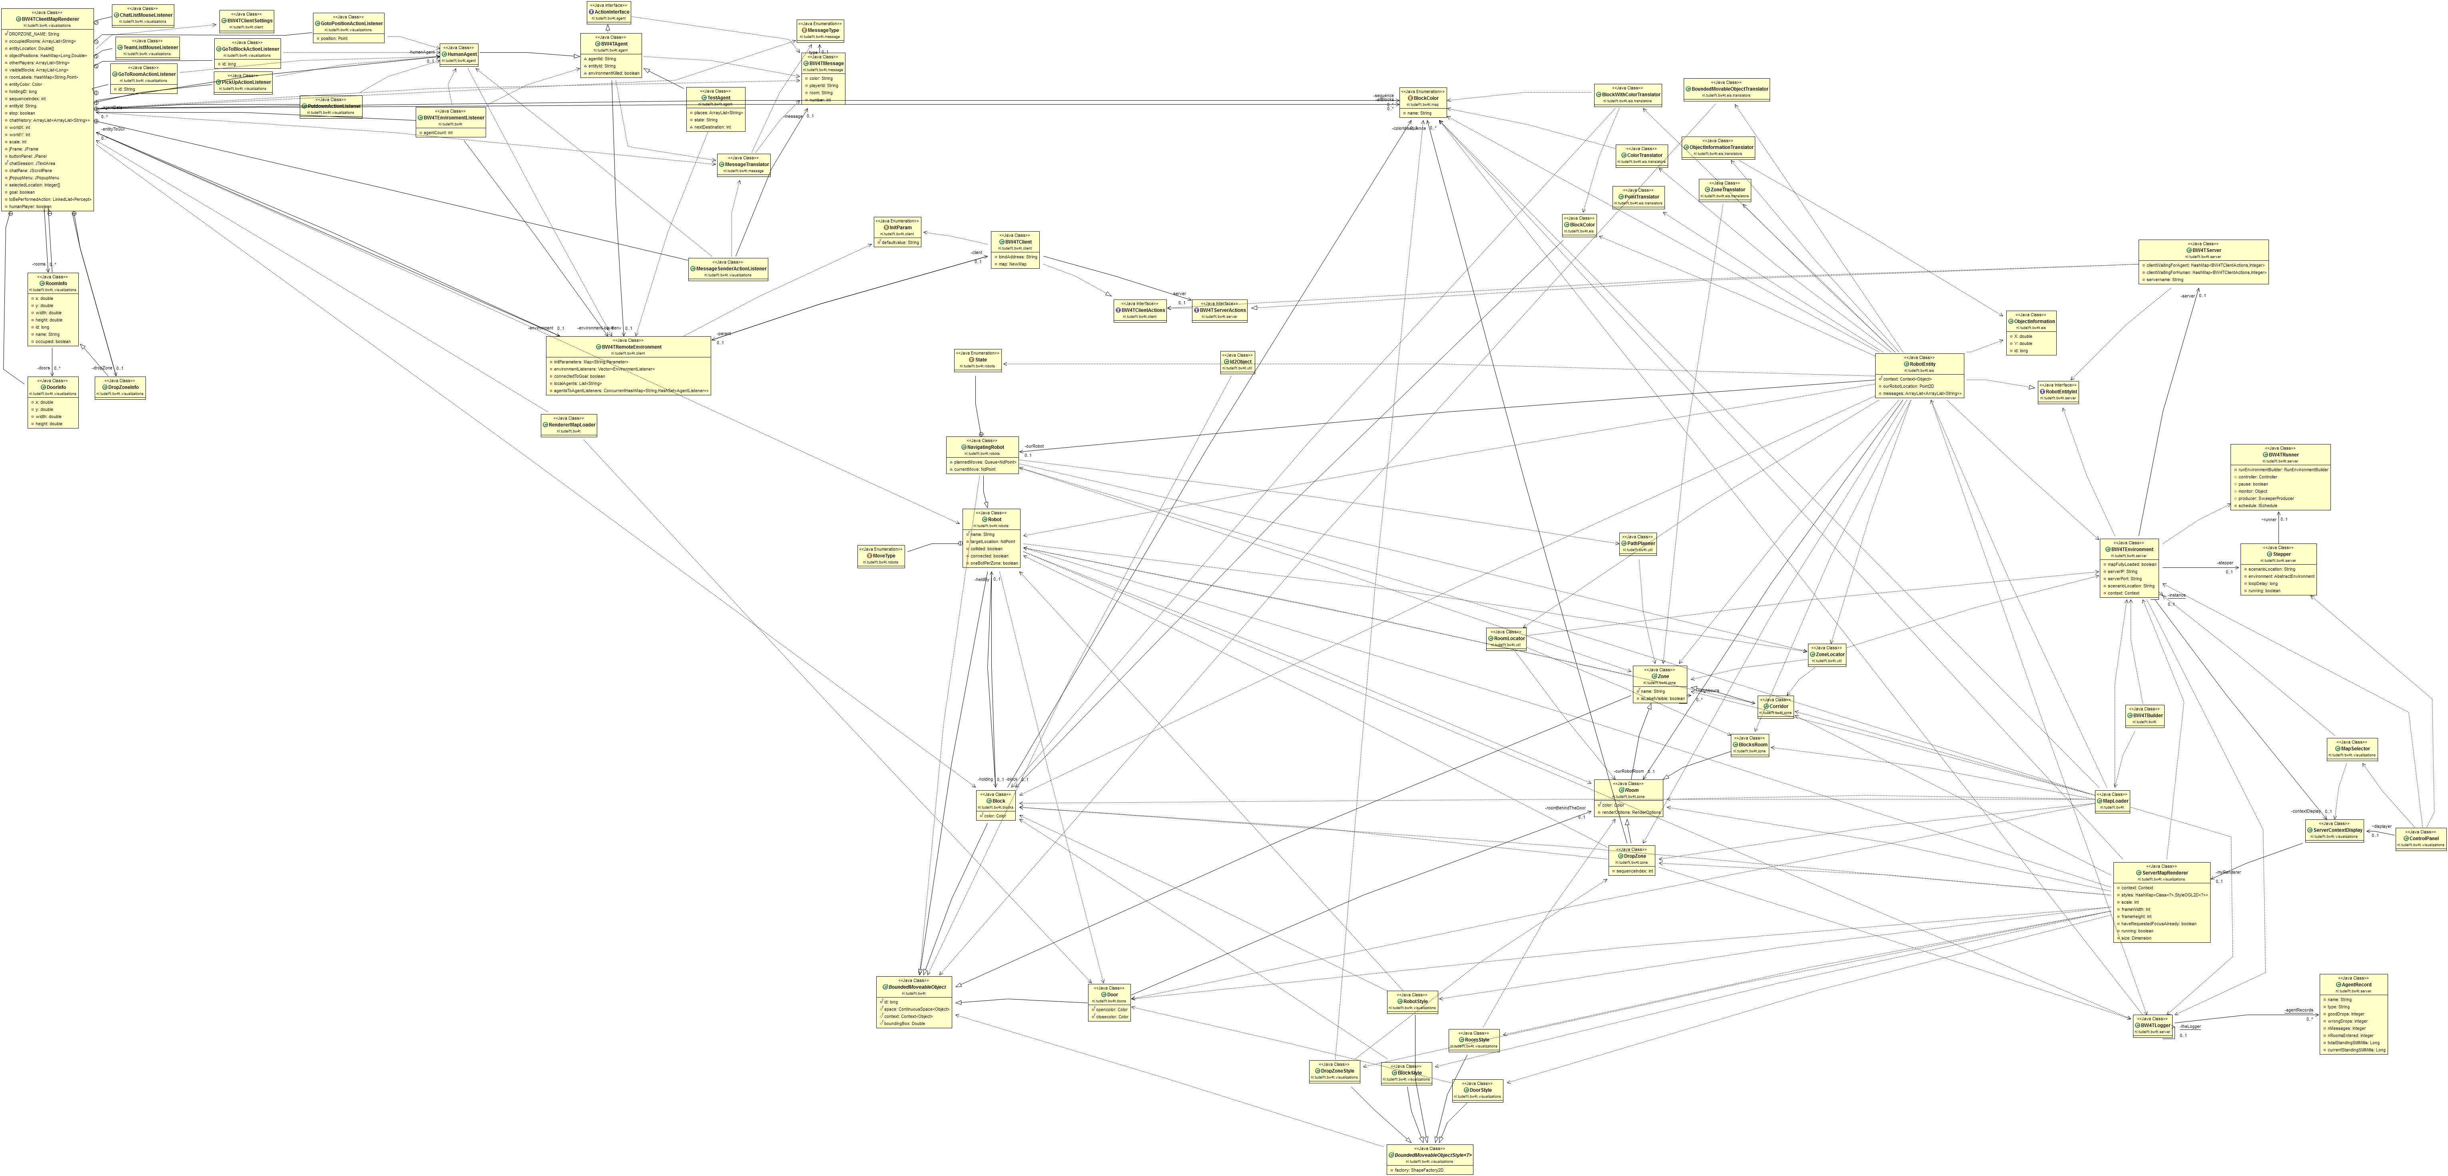
How it was
Situation
Refactor
Extend

Slide 4
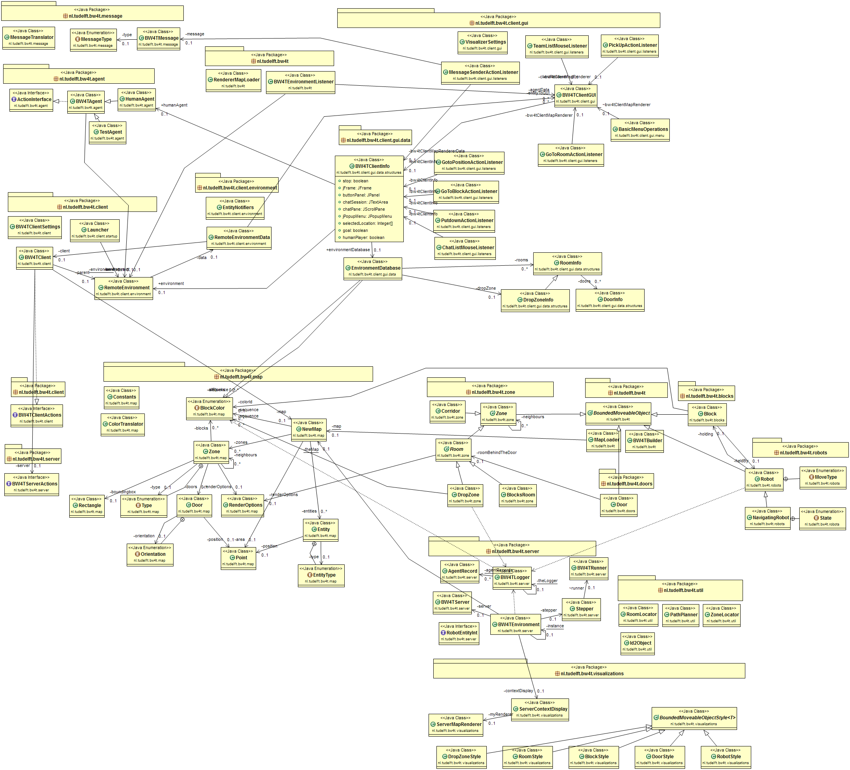
How it is now
Situation
Refactor
Extend

Slide 5
Sonar
What
Before
After
Lines of code
5.751
18.586
Situation
Unit Tests Coverage
0%
50,4%
Amount of issues
630
399
Refactor
Complexity per function
2,7
1,8
Amount of files
56
282
Extend
Amount of classes
71
341

Slide 6
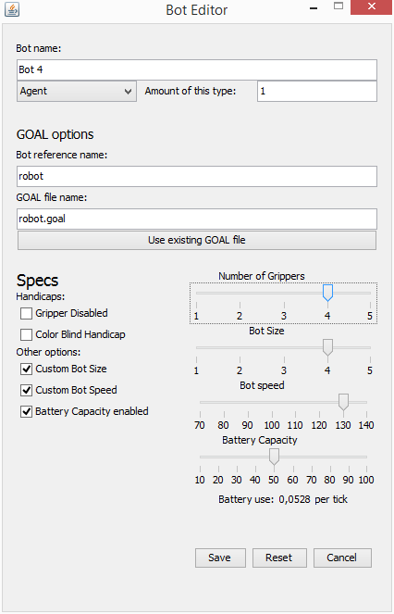
Bot Editor
Situation
Refactor
Extend

Slide 7
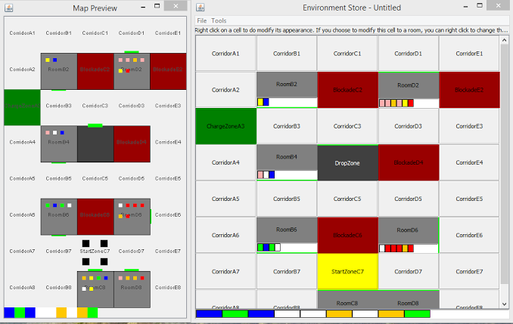
Environment Store
Situation
Refactor
Extend

Slide 8
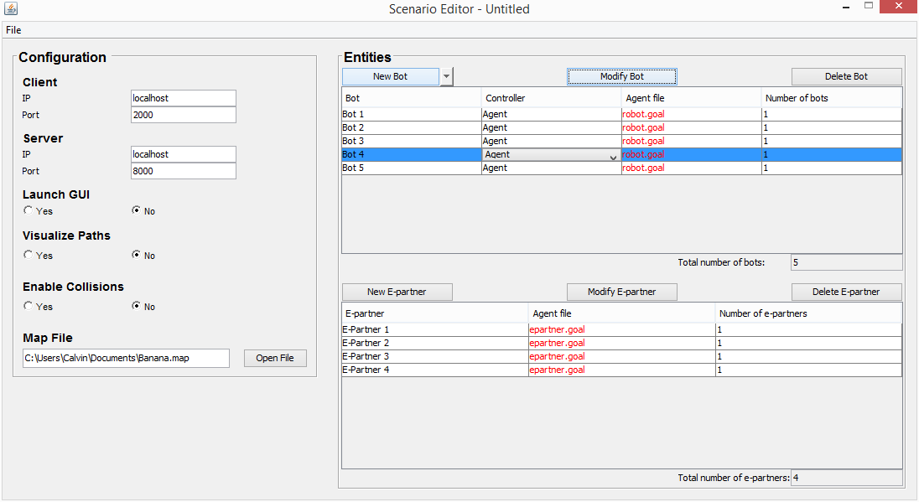
Scenario Editor

Slide 9
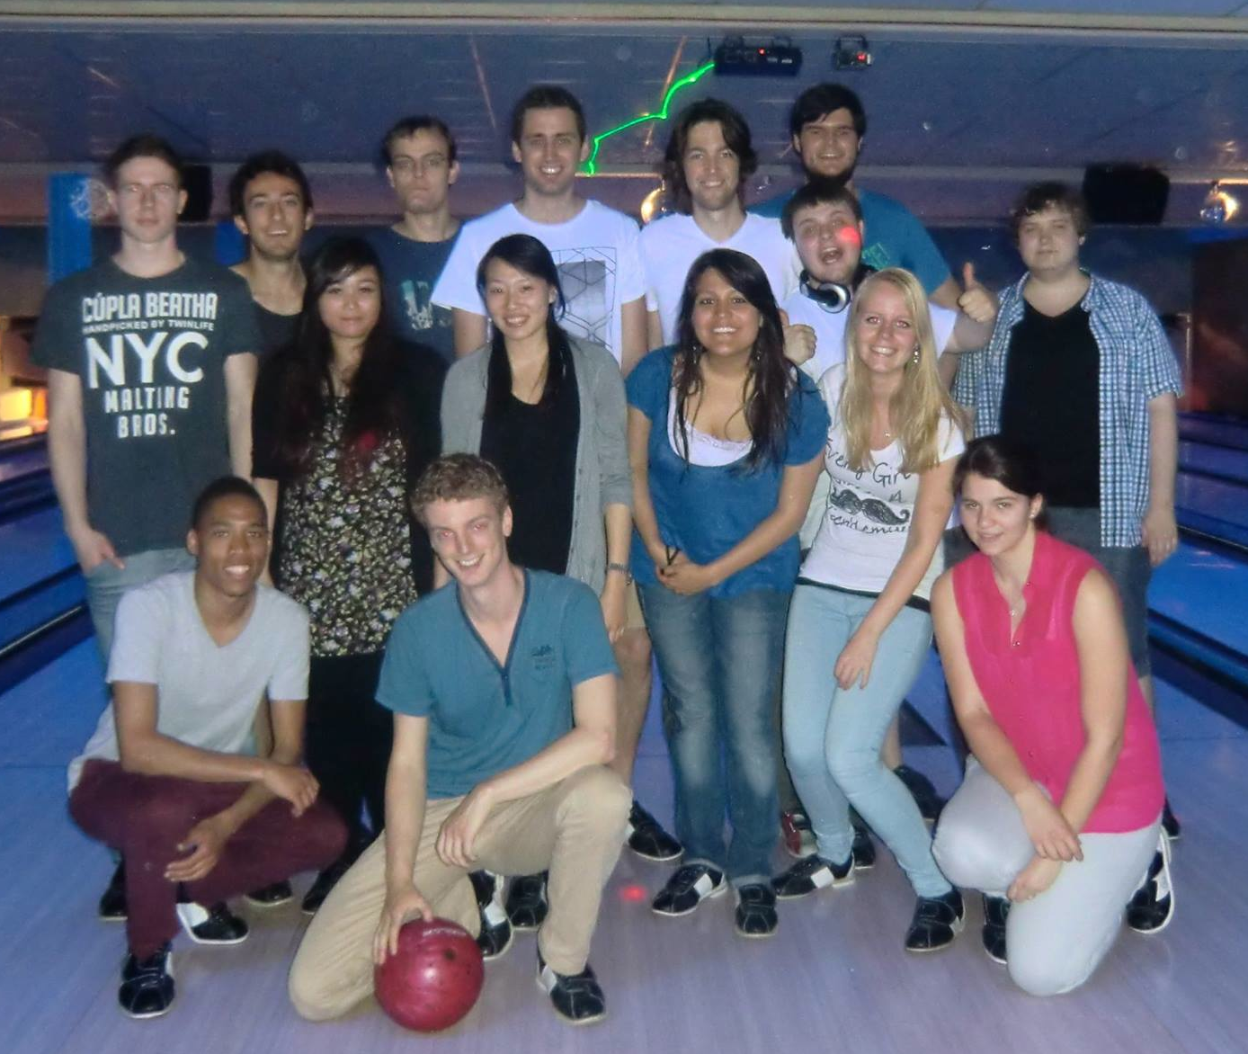
Some project statics
111 mails received from clients and coordinators
747 tests
217 pull requests
5 sprints
2198 commits
teambuilding
7 cakes
119 mails sent to clients and coordinators
19 students

Slide 10
Demo

